Slide 1
Backend Basics : Deploy on Azure
Atharva Chitre , Kukshi Shah

Slide 2

Microsoft Credits

Slide 3

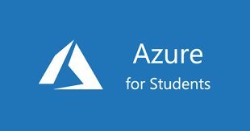
How to Claim?

Slide 4
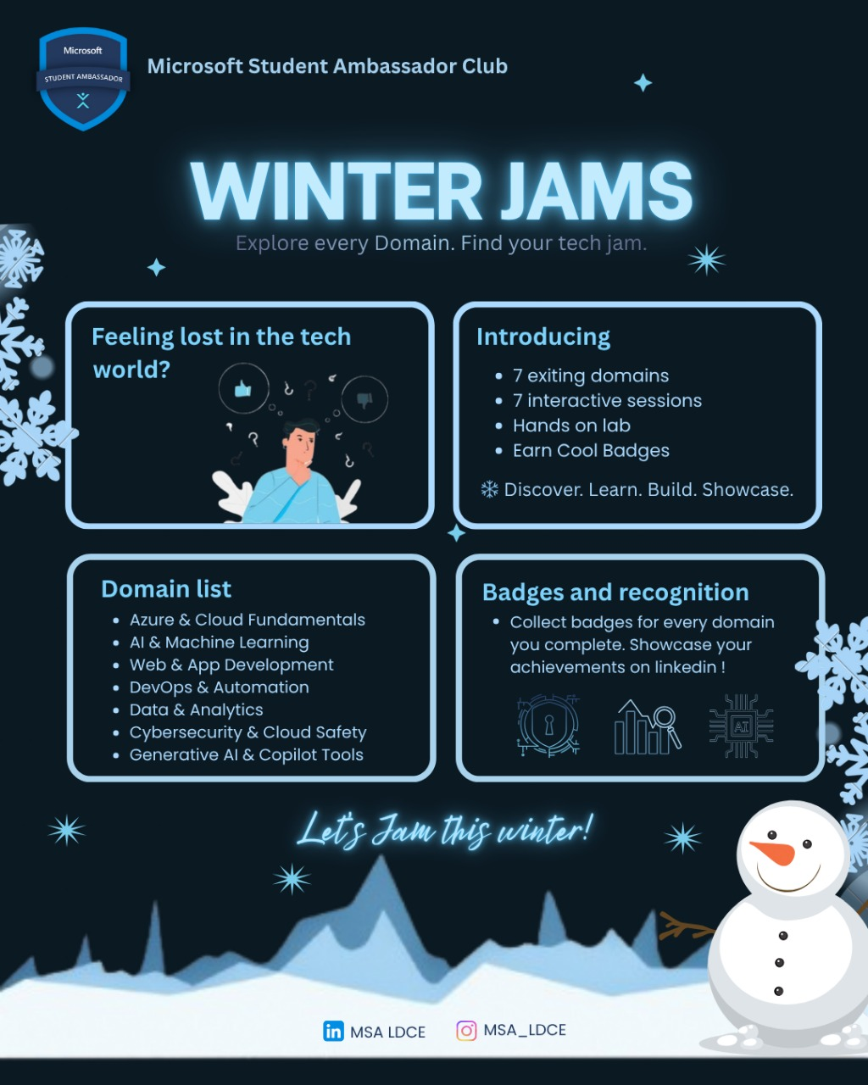
Announcements First!!!

Slide 5
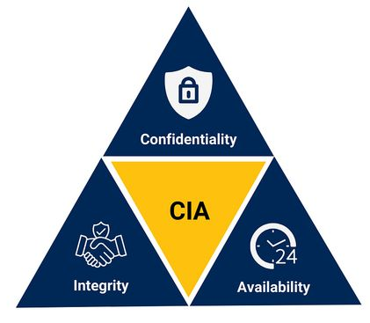
What Cybersecurity Means?
Cybersecurity is the practice of protecting:
Applications
Data
Users
Cloud resources
From:
Unauthorized access
Misuse & misconfiguration
Cybersecurity is built on the CIA Triad
Notes:
Cyber security Definition: Cybersecurity is not just hacking or attacks
It is about protecting systems before things go wrong
This entire idea is summarized by the CIA Triad Confidentiality: Only authorized users should see the data
Integrity: Data should not be changed without permission
Availability: Systems should be accessible when users need them Almost every cybersecurity incident breaks one or more of these three

Slide 6

Cybersecurity Roles & Career Paths
Beginner level salaries
SOC Analyst (Blue Team) - ₹4–8 LPA
Cloud Security Engineer - ₹8–15 LPA
Application Security Engineer - ₹7–12 LPA
Cybersecurity Analyst - ₹5 – 10 LPA
Penetration Tester / Ethical Hacker - ₹6 – 14 LPA
GRC / Risk Analyst - ₹5 – 9 LPA
Skills + practice + projects = opportunities
Notes:
Meme:- People often think , that doing certification only will land job , but in reality, only few certifications are respected and accepted in Big MNCs , so doing tons of certification won’t be beneficial Like many other computer related job , knowledge and projects are supreme SOC Analyst
Monitors security dashboards
Investigates alerts and suspicious activity
Works in a Security Operations Center (SOC)
No hacking, mostly analysis and response Cybersecurity Analyst
Broader role than SOC
Reviews security posture of systems
Helps identify risks and vulnerabilities
Works with logs, reports, and policies
Cloud Security Engineer
Secures cloud infrastructure (VMs, networks, services)
Fixes misconfigurations
Improves security posture and compliance
Very high demand due to cloud adoption
Application Security Engineer
Secures web and mobile applications
Reviews authentication and access logic
Helps developers fix security issues
Strong mix of coding + security
Penetration Tester / Ethical Hacker
Simulates attacks legally
Finds vulnerabilities before attackers do
Requires strong technical skills
Not beginner-friendly initially, but popular
GRC / Risk Analyst
Focuses on policies, compliance, and risk
Less coding, more documentation and analysis
Important for companies handling sensitive data
Good option for non-coders

Slide 7

NOW
Securing a Web Application in the Cloud
From insecure to secure — step by step
Notes:
Theory to practical session

Slide 8


The Plan
Build a simple web application in Azure
Deploy it on a server
Make it publicly accessible
Accidentally expose data
Identify security gaps
Apply security controls
Verify that data is protected

Slide 9

A Web Server?
A web server hosts applications
It listens on specific ports
It responds to requests from users
Build a simple web application in Azure
Deploy it on a server
How Applications Share Data
User sends a request
Server processes it
Server returns data
If access control is missing, data is shared with anyone.
Deploying the Application
Application is deployed on a cloud server.
Cloud servers have public IP addresses.
Anyone on the internet can reach them
Notes:
Say only this:
“We’ll start very simple.”
“For today’s demo, we are using a Python Flask web server.”
“This server is running on an Azure Virtual Machine.”
Point to the slide:
“A web server listens on a port and responds to user requests.”
“Every application works the same way: request → process → response.”
Emphasize once (important line):
“The server does not know who is good or bad by default.”
Then move to deployment:
“When we deploy this Flask app on an Azure VM…”
“It gets a public IP address.”
“That means anyone on the internet can reach it.”
✅ Key takeaway (say this clearly):
“Once an application is deployed on a cloud server, it is public by default.”

Slide 10

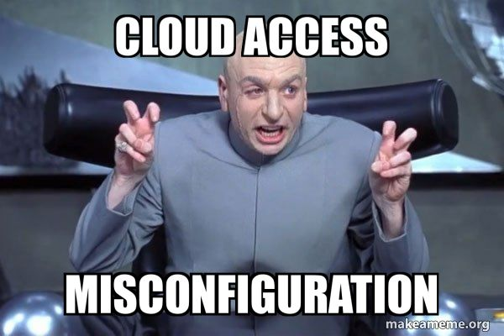
What happens after deployment?
App gets a public URL
Anyone can access endpoints
No identity checks by default
Make it publicly accessible
Accidentally expose data
Security impact
Sensitive data is exposed
Confidentiality is broken
If security is missing, exposure is automatic.
Notes:
Say:
“Now the important question.”
“What actually happens after deployment?”
Go through bullets once:
“The app gets a public URL.”
“Anyone can access its endpoints.”
“There are no identity checks by default.”
Point to the meme:
“This looks funny, but this is real.”
“Most cloud security issues happen because of misconfiguration.”
Move to security impact:
“When this happens, sensitive data gets exposed.”
“Confidentiality is broken.”
Say this exact line (very important):
“This is not hacking. This is a configuration mistake.”
Connect to your demo:
“Our Flask app works perfectly.”
“But it does not enforce identity or access control.”
“So anyone who knows the URL can access the data.” Finish with:
“We didn’t hack anything — we just deployed an insecure app.”

Slide 11
Identifying & Fixing Security Gaps
For this, we will use Microsoft Security Tools
Identify security gaps
Apply security controls
1. Microsoft Defender for Cloud
2. Identity & Access Management (IAM)
What we will do:
Analyze our Flask server’s security setup.
Identify risky cloud configurations.
Restrict public access to sensitive data.
Apply security fixes using Microsoft tools
After applying security controls
Data is no longer publicly accessible
Access is limited to authorized users
Notes:
“So now we understand the problem.”
“We have a simple Flask web server running on an Azure Virtual Machine, and it is publicly accessible.”
“This slide shows the entire plan of our practical session.”
“First, we will identify security gaps in how our server is deployed.”
“Then, we will apply security controls to fix those gaps.”
“In the demo, I will analyze the Flask server’s cloud security setup.”
“We’ll identify risky cloud configurations and restrict public access to sensitive data.”
“To do this, we’ll use two Microsoft security tools: Microsoft Defender for Cloud and Identity & Access Management.”
“After applying these controls, the data should no longer be publicly accessible.”
“Only authorized users should be able to access it.”
“Let’s start by understanding the first tool — Microsoft Defender for Cloud.”

Slide 12

Microsoft Defender for Cloud
Microsoft Defender for Cloud is a cloud security service that helps you:
Understand your cloud security posture
Detect misconfigurations and risks
Get actionable security recommendations
What does it protect?
Virtual Machines (servers)
Web applications
Networks & ports
Cloud configurations
Notes:
“Now let’s talk about the first tool we’ll use — Microsoft Defender for Cloud.”
“Microsoft Defender for Cloud is a cloud security service that helps us understand how secure our cloud resources are.”
“It looks at how things are configured, not how the code is written.”
“In our case, it will analyze the Azure Virtual Machine where our Flask server is running.”
“Defender helps us: understand our cloud security posture, detect misconfigurations, and get clear security recommendations.”
“It can analyze virtual machines, web applications, networks, open ports, and cloud configurations.”
“This tool does not hack anything and does not change our code.”
“It simply tells us what is risky and what needs attention.”
“Next, we’ll look at how identity helps us control who can access the application.”

Slide 13

Identity & Access Management (IAM)
Microsoft Entra ID helps you:
Verify who the user is
Control what they can access
Prevent unauthorized access
Why Identity Matters
Public URLs are accessible to everyone
Applications must verify users
Data should not be shared with unknown users
Identity & Access Management (Microsoft Entra ID)
Notes:
“The second important part of security is identity and access.”
“For this, we use Microsoft Entra ID, which is Microsoft’s Identity & Access Management service.”
“Identity answers one simple question: Who is the user?”
“Access control answers another question: What is the user allowed to access?”
“Microsoft Entra ID helps us verify users, control permissions, and prevent unauthorized access.”
“This is important because public URLs are accessible to everyone by default.”
“Applications should not trust every request just because it reaches the server.”
“In our Flask application, there is currently no identity check, which is why data is exposed.”
“Instead of hardcoding usernames and passwords in code, real applications use identity systems.”
“In the demo, we’ll see how identity helps restrict access to authorized users only.”
“Now that we understand both tools, we can apply security controls in our demo.”

Slide 14

What we verify
Data is no longer publicly accessible
Unauthorized users are blocked
Access is allowed only after verification
Verify that data is protected
How we verify it
Try accessing the application without identity
Observe restricted access
Confirm expected behavior
After issue is patched up
Notes:
“Security doesn’t end after applying fixes.”
“We always verify that the fix actually worked.”
“In the demo, we’ll try to access the data again.”
“If security is working, the data should not be visible without authorization.”
“This is how security is validated in real projects.”

Slide 15
Time to get started

Slide 16

Take our two-question survey

Slide 17
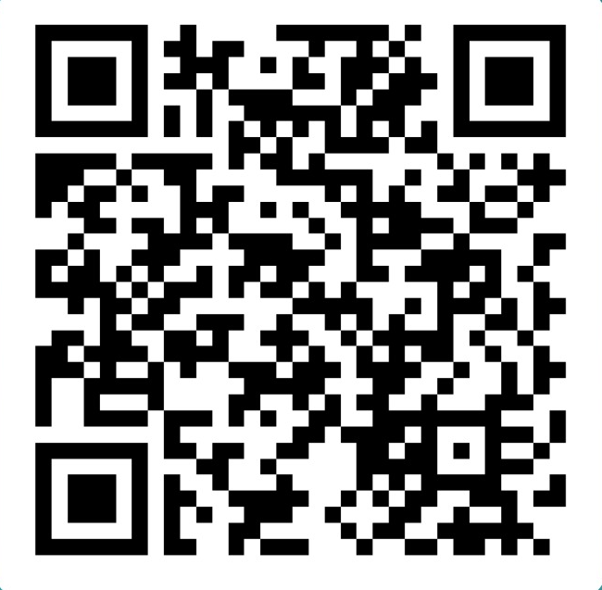
Scan and fill to get certificate

